Slide 1
Chapter 5: Natural Language Classifiers
Learning Bluemix & Cognitive
Bob Dill, IBM Distinguished Engineer, CTO Global Technical Sales

Slide 2
Chapter 4: Classifying short phrases
What is a classifier?
Creating classifiers
Enabling the service
Creating the csv file
Creating the classifier
Telling your application how to access the classifier
Looking at the classification results

Slide 3
What is the Watson NLC Service?
The IBM Watson Natural Language Classifier service applies deep learning techniques to make predictions about the best predefined classes for short sentences or phrases, generally 1000 characters or fewer. The classes can trigger a corresponding action in an application, such as directing a request to a location or person, or answering a question. After training, the service returns information for texts that it hasn't seen before. The response includes the name of the top classes and confidence values.
The service is trained by supplying a text (comma-separated-values) file with a phrase and then the target classification. A partial example from an industry classification file follows:
797 char
A&D businesses, AerospacDefense
A&D industry, AerospacDefense
A&D M&A, AerospacDefense
A&D products, AerospacDefense
aerospace prime contractors/, AerospacDefense
aftermarket service offerings, AerospacDefense
air travel, AerospacDefense
aircraft industry, AerospacDefense
airline travel, AerospacDefense
asset availability, AerospacDefense
asset related data, AerospacDefense
budget deficits, AerospacDefense
commercial acquisition practices, AerospacDefense
commercial aircraft industry, AerospacDefense
complete products, AerospacDefense
complex value chains, AerospacDefense
contractors/ system integrators, AerospacDefense
corporate support functions, AerospacDefense
defense industry, AerospacDefense
defense prime contractors/, AerospacDefense
development costs, AerospacDefense
domestic air travel, AerospacDefense
first-tier subcontractors, AerospacDefense
fourth-tier subcontractors, AerospacDefense
fuel costs, AerospacDefense
fuel-efficient aircraft, AerospacDefense
fundamental A&D research, AerospacDefense
global supply chains, AerospacDefense

Slide 4
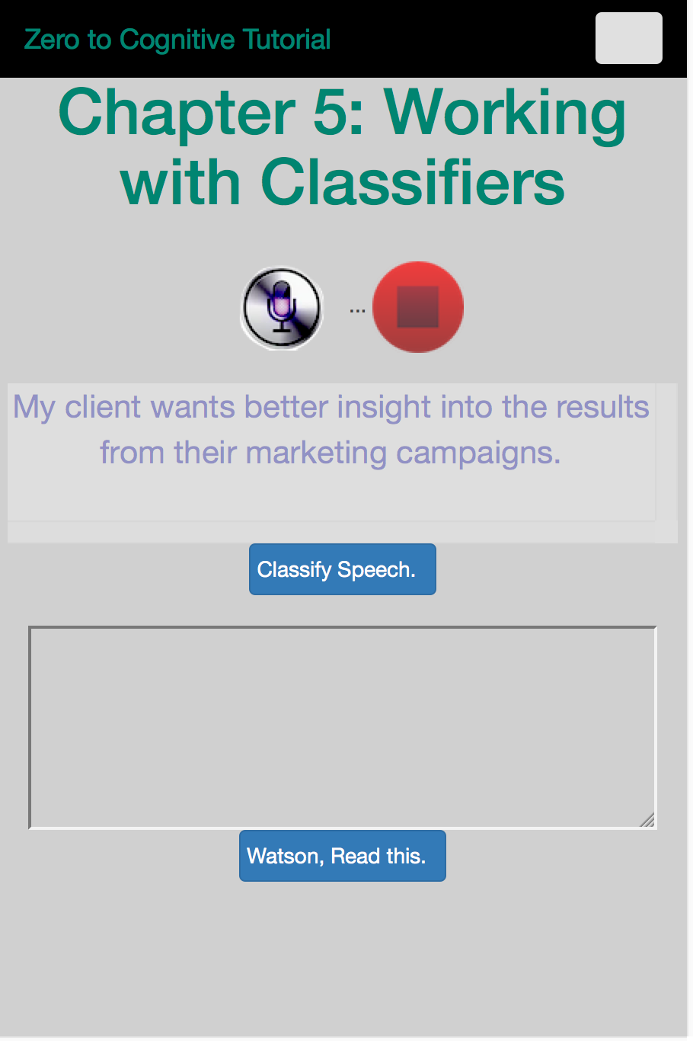
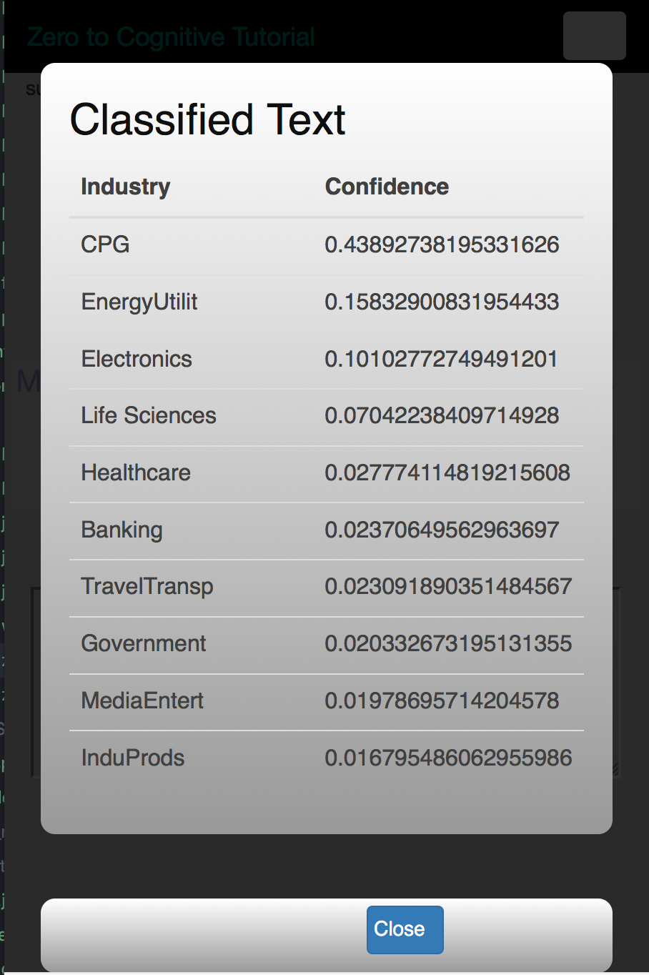

We will enhance our original app to display the results from classifying your spoken words.
We will add a “classify” button to the index.html file.
Which will create a pop-up page to display the results of the Natural Language Classification

Slide 5

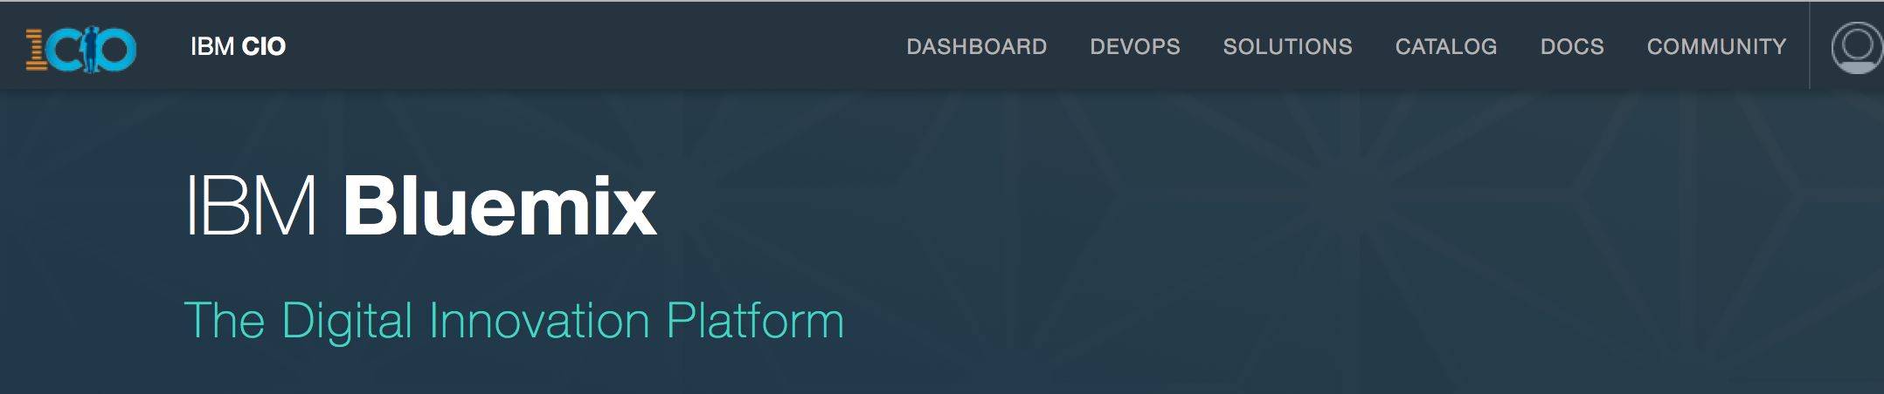
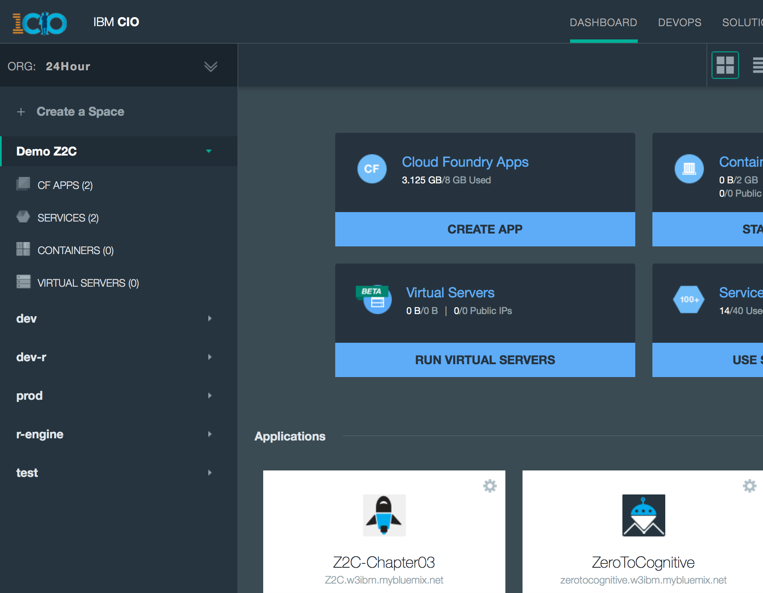
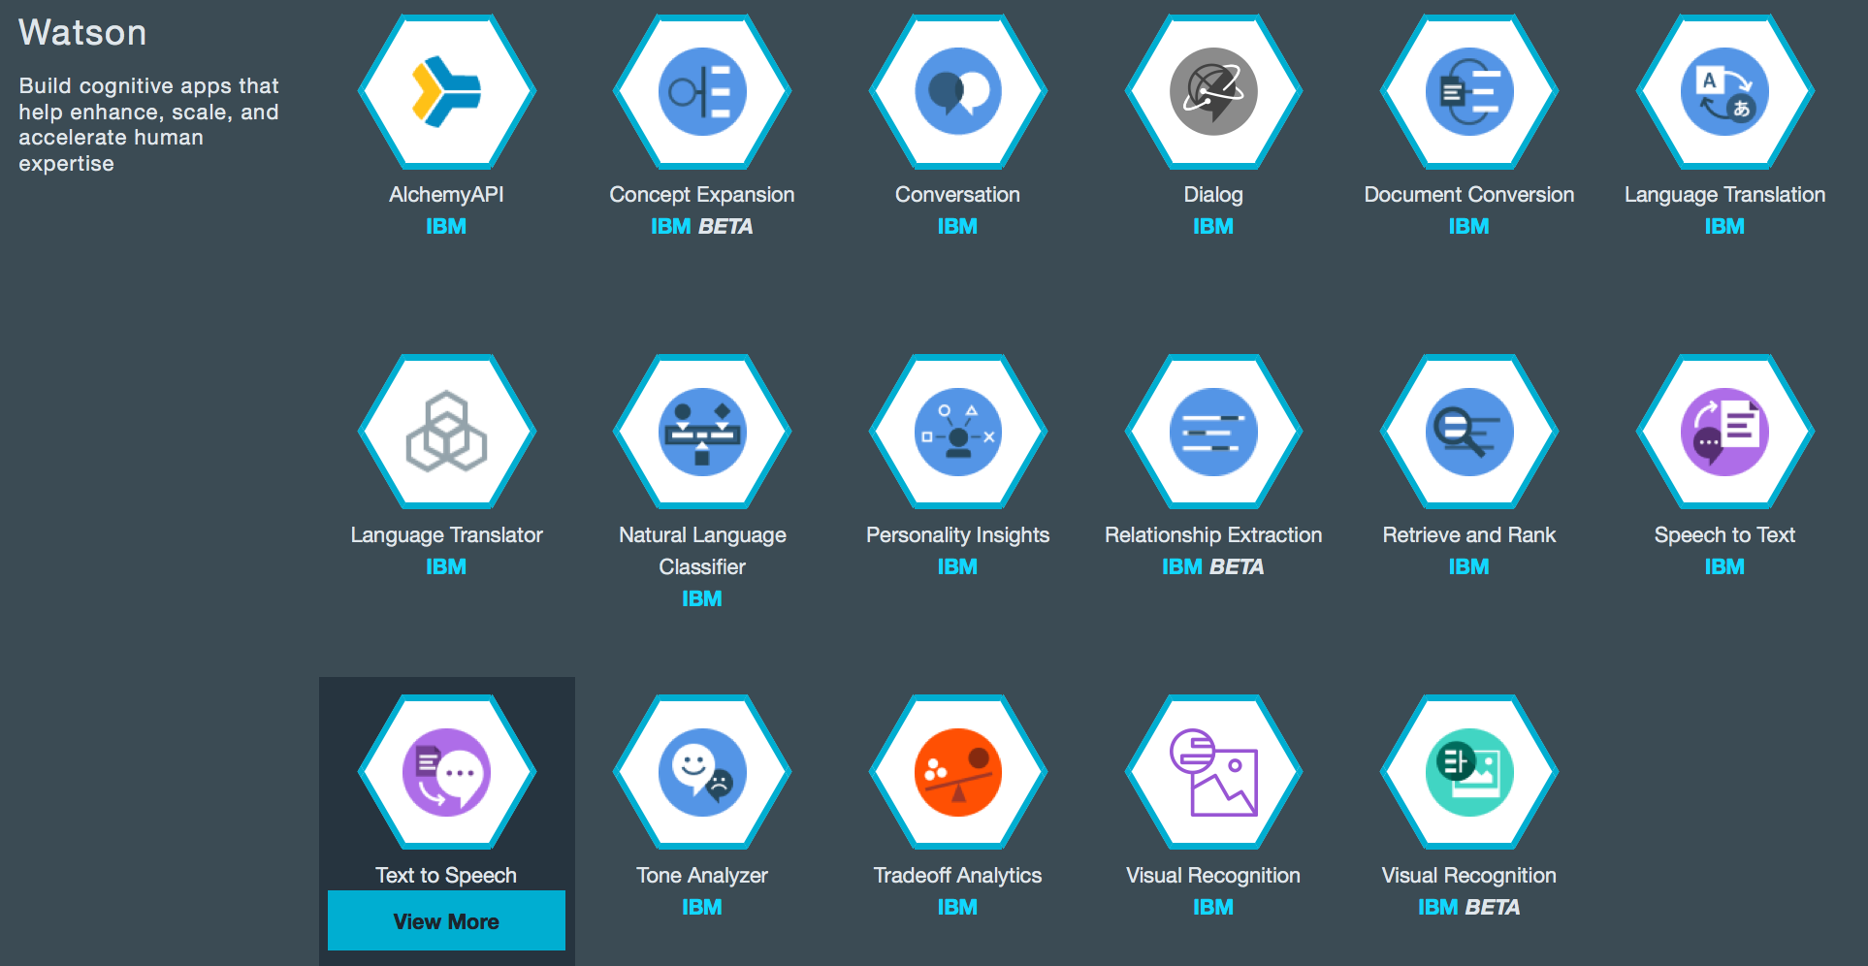
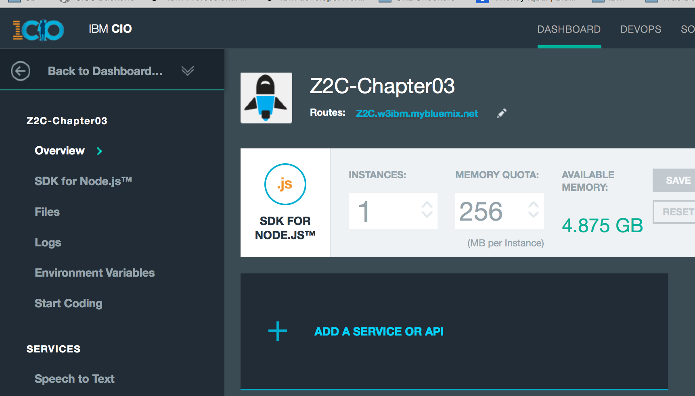
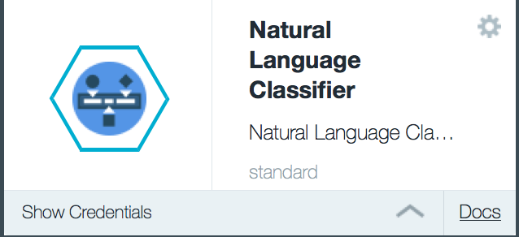

Watson NLC
Add the service:
Go to your Bluemix dashboard and to your app.
Add a service or API
Select Watson Natural Language Classifiers
Get your credentials

Slide 6
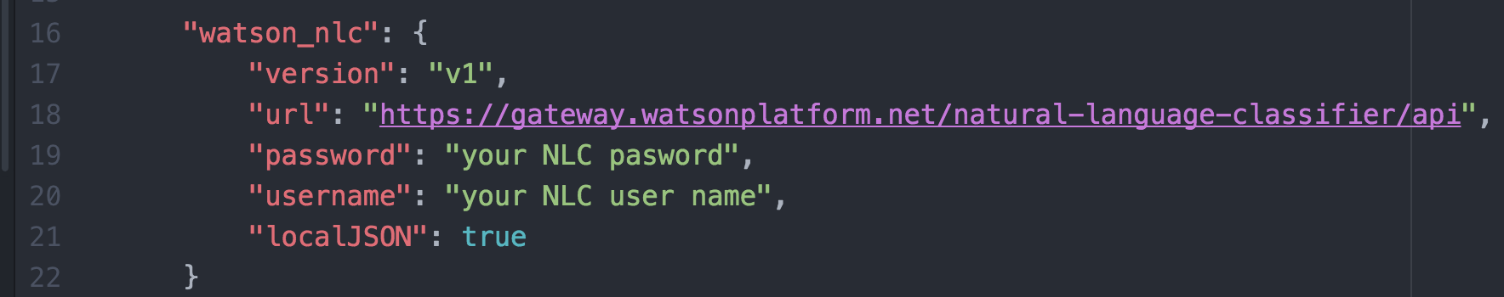
Update your credentials file
By now, this should be looking very familiar.
open your env.json file and add your credentials for Natural Language Classification

Slide 7
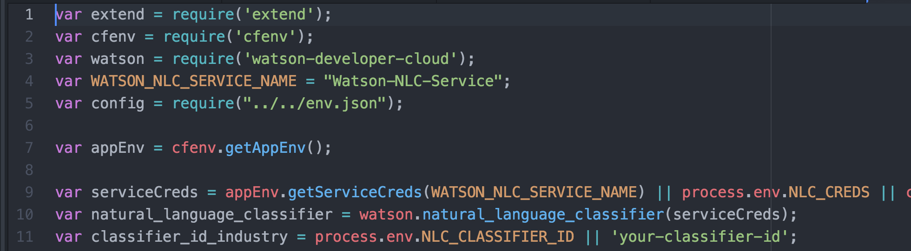
Create a new restful service to do the classification
Continuing in our theme of keeping unique parts of the program separate, we will create a new file for our classification. We have to add two lines to our ‘router.js’ file so that it can find the new services.
The classifier.js file will have 2 functions in it and the same kind of require statements as we have previously used.
lines 1-5 define required resources
line 7 gets the execution environment
lines 9-10 set up NC
line 11 defines the classifier we will use.

Slide 8
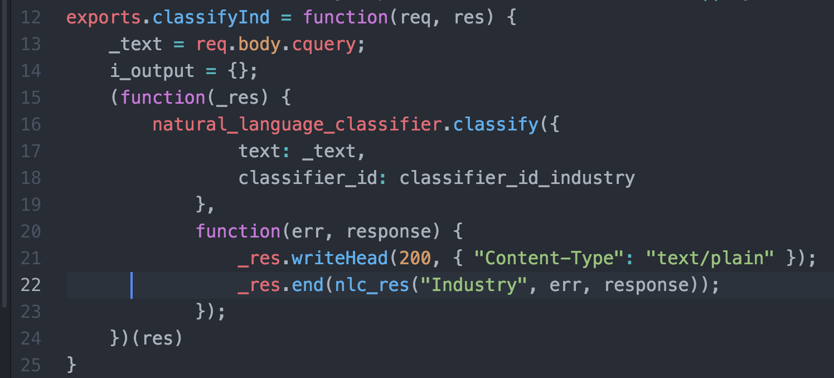
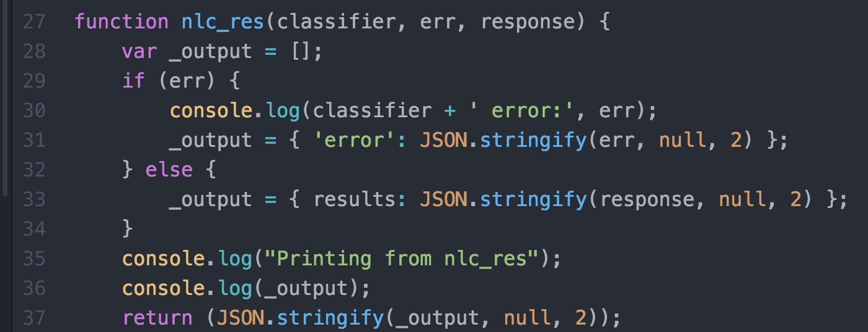
Creating the restful service (II)
Line 12 names the exported service, This is what the router sees
Line 13 gets the text from the post
Line 15 defines an anonymous function, which on
Line 16 calls the classifier and
Line 20 returns the results which are
Line 22 sent to a formatting function
Line 29 check if the call was successful
Lines 30-31 format an error message
Lines 32-34 else format the classification
Line 37 format and send the results back (note that JSON.stringify was called twice)

Slide 9
curl on your local machine
“curl”, or Command-line URL, is a utility on your laptops.
Windows:
Open the git bash shell (this was installed when you installed git on your laptop).
The git bash shell looks like a windows command prompt with unusual colors.
Execute the curl commands from within the git bash shell
OSX
If you don’t already have curl installed, I recommend that you use the “homebrew” service.
If you don’t already have home-brew installed, go here: http://brew.sh/ and follow the directions. Once you have home-brew installed, type this command in a terminal window: brew install curl and press enter.
you can now execute curl commands from a terminal window
Linux
If you don’t already have curl installed, type the following command in a terminal window: sudo apt-get install curl and press enter. provide your laptop log in password when requested.
you can now execute curl commands from a terminal.

Slide 10
Creating your own Natural Language Classifier
To create a classifier, you need a .csv file with text strings and classification terms. This Chapter has an industry classifier which was used as part of another project. It is called “industry.csv”.
you can create a classifier either from within an application, or directly from your terminal/command prompt window. We will do this from a terminal window.
Enter the following command, using your user-id and password credentials from Watson NLC:
Change the to Chapter05/Documentation folder (cd ~/Documents/GitHub/ZeroToCognitive/Chapter05/Documentation)
curl -u "your user name":"your password" -F training_data=@industry.csv -F training_metadata="{\"language\":\"en\",\"name\":\"Industry2016\"}" "https://gateway.watsonplatform.net/natural-language-classifier/api/v1/classifiers"
Write down the classifier_id value returned by Watson when you enter this command and put this into line 11 in your classifier.js file
Check the status of your classifier by entering the following command:
curl -u "your user name":"your password" "https://gateway.watsonplatform.net/natural-language-classifier/api/v1/classifiers/your-NLC-Classifier-id"
You can use your classifier when the returned status shows that the process is complete. This typically takes 10-15 minutes.
List all of your classifiers:
curl -u "your user name":"your password" "https://gateway.watsonplatform.net/natural-language-classifier/api/v1/classifiers"
Delete a specific classifier:
curl -X DELETE -u "your user name":"your password" "https://gateway.watsonplatform.net/natural-language-classifier/api/v1/classifiers/your-NLC-Classifier-id"

Slide 11
Using the results from the classifier
Watson NLC returns a JSON object with the results of the classification. The part of the object about which we care is the “classes” array. Everything else is interesting, but we don’t need it for what we’re doing.
The classes array has up to ten 2-value pairs. The first value is the name of the classifier (in our case, an industry name) and the second has the probability that this is the correct match.
Our browser-side javascript has to do 3 things:
Activate the “classify” button
Get the text to be classified and send it to the restful service
Get the results from the restful service and display them.

Slide 12

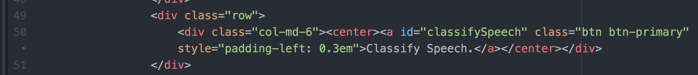
Update index.html
Keeping our principle of ‘separation of concerns’ in mind, we’re going to make a very small modification to the index.html file and then create a new html file to display the results of the classification.
We need to add a button to the index.html file and we will add a second javascript file as well:
we will add 4 lines of code.
Row 32 creates a placeholder for the modal dialog
Rows 49 and 51 just specify that this is a “row” kind of an addition. Line 50 is the actual button.
And we will put all of the javascript code associated with NLC into a new file.

Slide 13
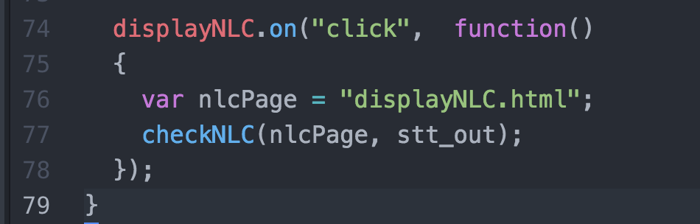
Activate the classify button
We’re only going to add a couple of lines to the initPage function. The body of the logic associated with the new button will go into the new browser javascript file.
We will create the ‘checkNLC’ function in the z2c-NLC.js file.

Slide 14
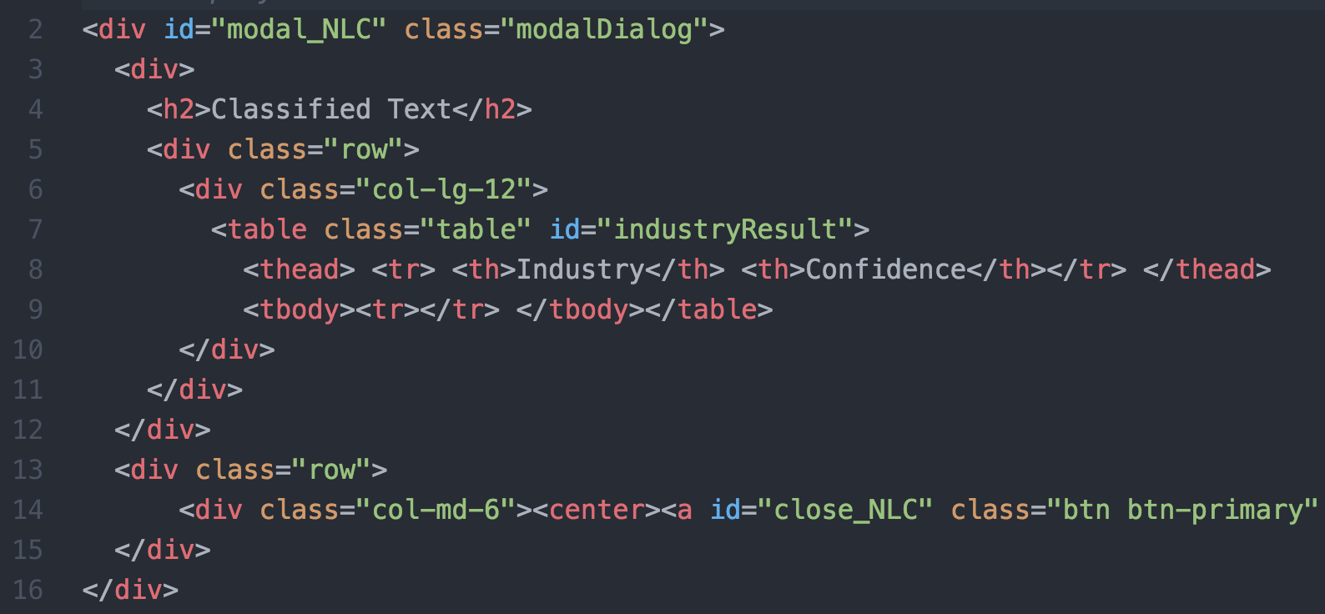
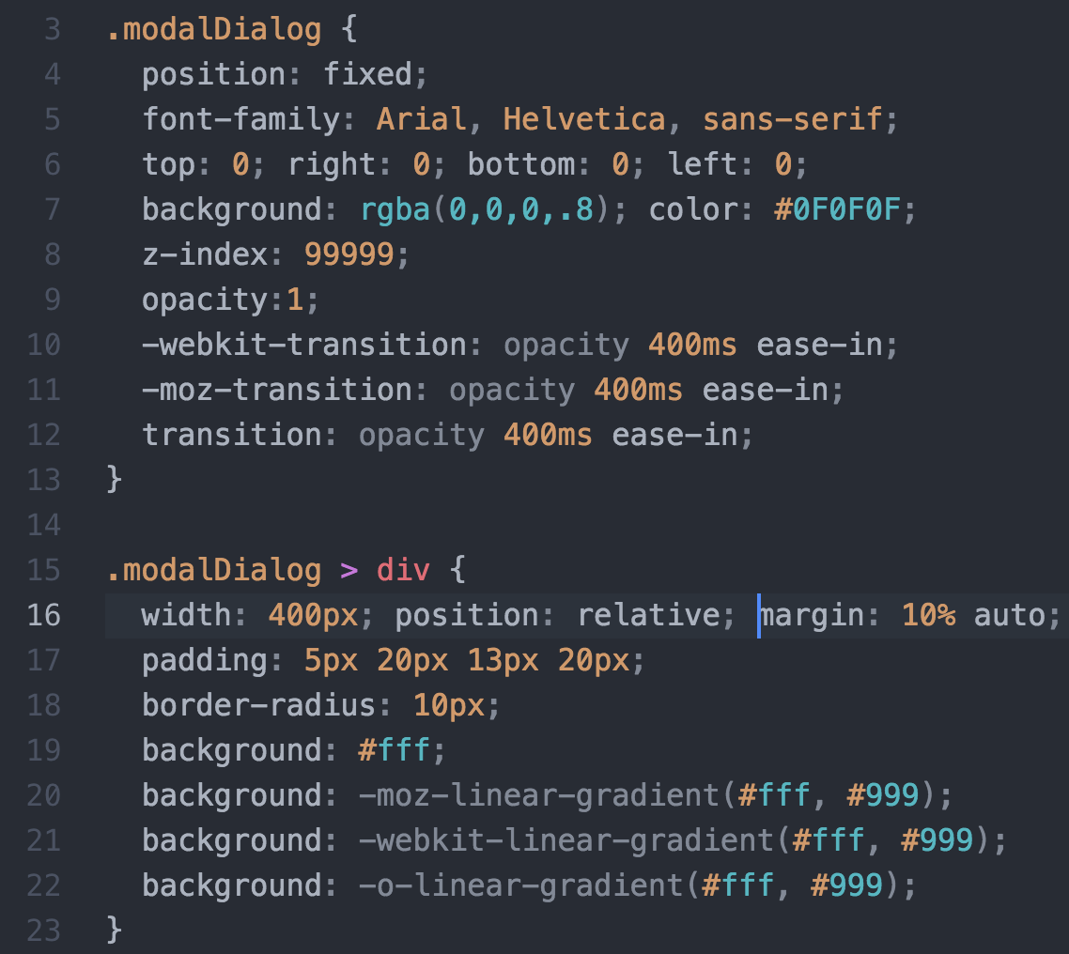
Browser: Display the NLC results (2)
The NLC results are displayed on a pop-up page using a combination of an HTML page fragment and some CSS coding.
The two key elements on this page are lines 7-8 and line 14.
Lines 7-8 define the table for displaying the results
Line 14 has the button we’ll use to close the window.
The CSS to the left has two sections. The upper controls the black background for the pop-up window, the lower controls how the table with the NLC results will be displayed.

Slide 15
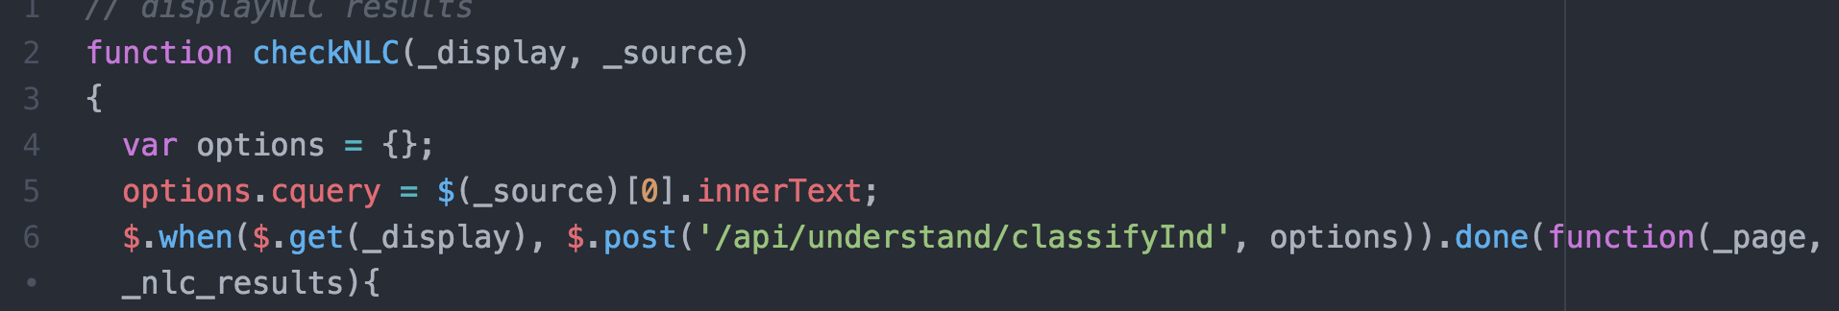
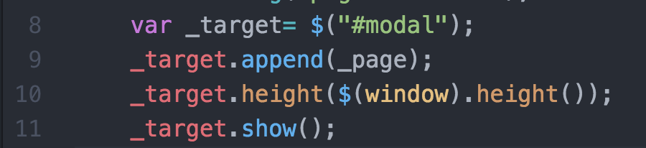
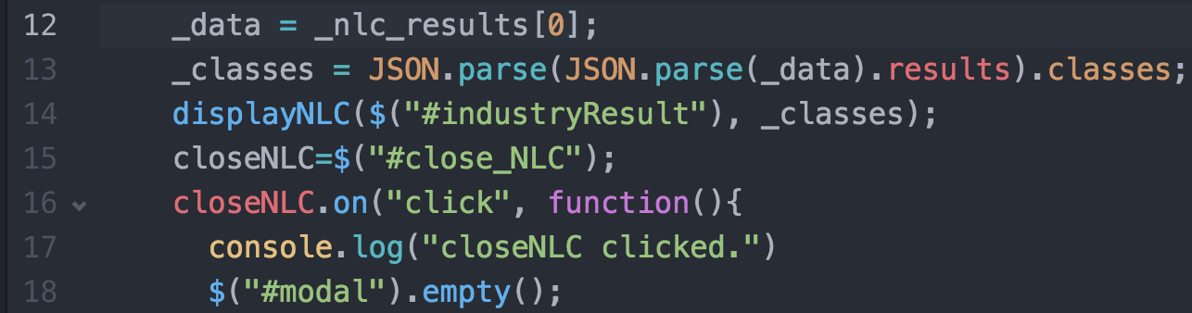
Browser: Activate the button, get text, send it to the server
Activation is handled in the ‘displayNLC.on’ code written earlier
Line 2 defines the function
Line 5 gets the text to be analyzed and places it in an object
Line 6 which is used in a post to the server.
Line 6 also retrieves an html page fragment (html file) which will be used to display the results from the classification process. The jQuery $.when().done() function allows us to send a series of requests in parallel and then use the combined results when all server calls have completed. The results are returned in the variables defined at the end of line 6 (_page and _nlc_results)
We're creating a modal (can’t do anything else until this window is closed) window to display the NLC results.
lines 9-11 take the retrieved html template and display it
Lines 12-13 extract the classes from the NLC JSON object
Line 14 calls a formatting routine
Lines 15-18 activate the close button for this window

Slide 16
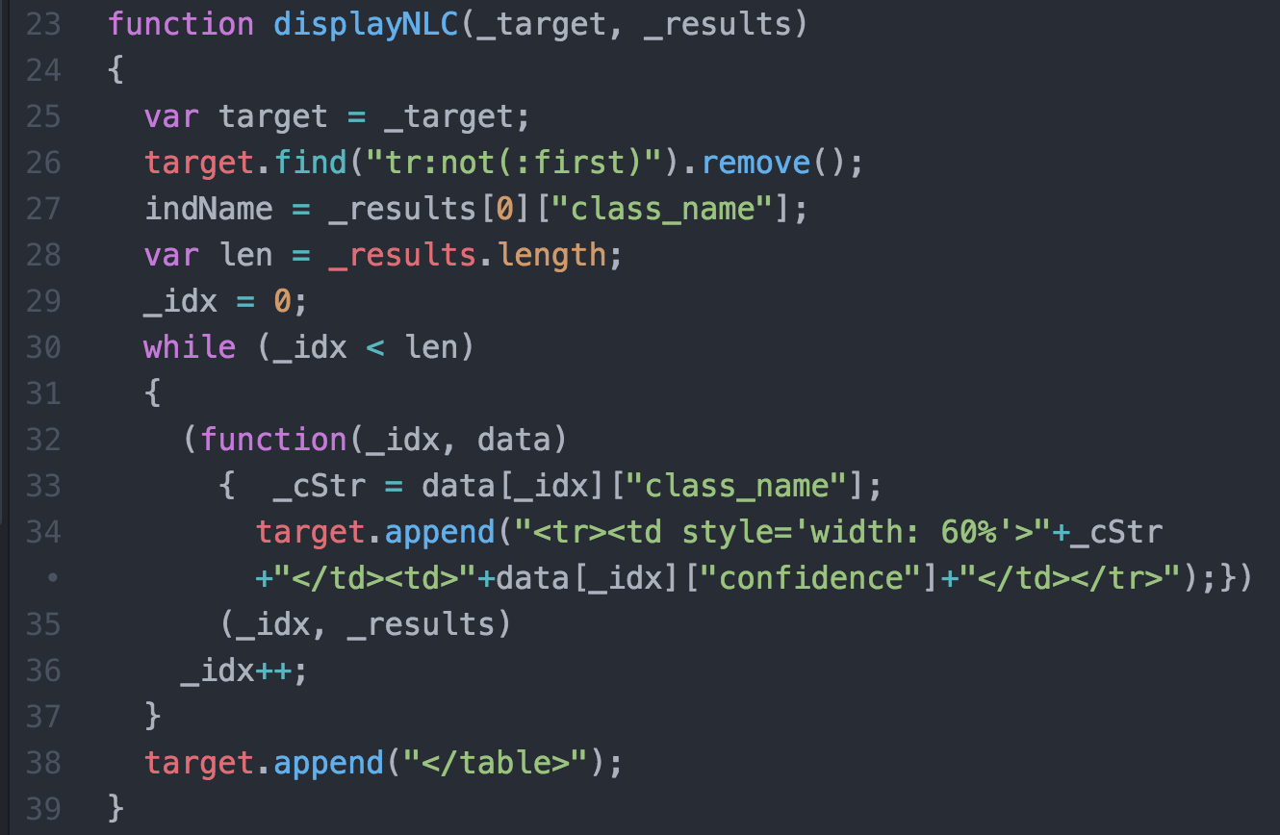
Browser: Display the NLC results (1)
Line 23 defines the function
Line 25 empties the table
Line 28 initializes a variable for the while loop
Line 29 loops through all of the returned classifiers
Lines 32-35 process the data for the loop
we’re using an anonymous function
this is highly recommended whenever loops are processed in Javascript.
The loop is passed a counter and the classes table on line 35
Line 34 uses those values in a ‘safe’ space to create the table

Slide 17
The Plan: 30 minute Chapters with an hour or two of practice
The Story, Architecture for this app
Setting up Bluemix
Building your first Watson App (Watson Speech to Text)
Getting Watson to talk back (Watson Text to Speech)
Understanding Classifiers (Watson NLC)
Creating a custom dialog with Watson (custom Q&A, session management)
Authentication (puts C2 thru 6 together)
Alchemy News (Watson Alchemy)
Visual Recognition and Images (Watson Visual Recognition)
Watson Conversations (Watson Conversations)
Rank & Retrieve (Watson Alchemy + Rank & Retrieve)
Getting started on my first client prototype Design Thinking, Stories, Architecture, Keeping it simple
Supporting Complex environments Public Bluemix and Docker
Supporting Complex environments II Bluemix Dedicated and CloudFoundry
Creating an Inference Engine Our Inference Engine in "R"
Finding solutions Integrates C1-10, 13-15)
BlueMix, Watson and Mobile (TBD)
September-October
4Q

Slide 18
Chapter 6: Understanding Classifiers
Learning Bluemix & Cognitive
Bob Dill, IBM Distinguished Engineer, CTO Global Technical Sales

